Slide 1
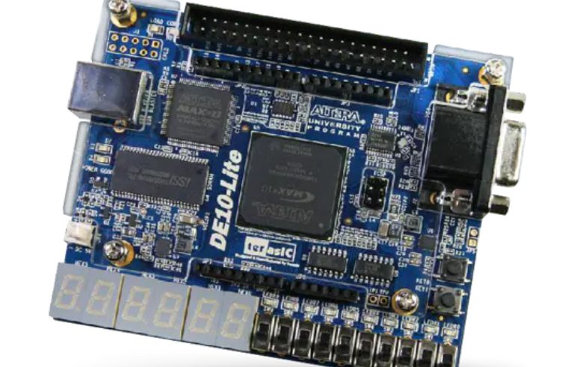
Accelerometer module for an FPGA development environment
Loïc Finette
Terasic DE10-Lite
Source: eu.mouser.com
School of Engineering IEM BNMS Accelerometer module for an FPGA development environment

Slide 2
Main Goal
To allow the accelerometer on the DE10-Lite to be easily usable through Logisim

Slide 3
Concretely
Implement a driver for the accelerometer
Make a test bench to show the information from the driver on the FPGA
Make a simulator to show the information from the driver in Logisim
Create an application that uses the accelerometer driver

Slide 4
Motivation
To allow the students in EE110 – Systèmes Logiques to use the accelerometer for their projects.

Slide 5
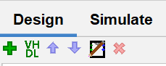
State of the art
UC Davis (Verilog)
Mark Hildebrand (Verilog)
Blake Johnson (VHDL)
Screenshot of Logisim

Slide 6



Project Overview
Software Installation
(Quartus, Logisim)
Source: github.com
Source: jackenhack.com
Source:github.com/logisim-evolution/logisim-evolution
Driver Simulator
Application
Driver + Test Bench

Slide 7
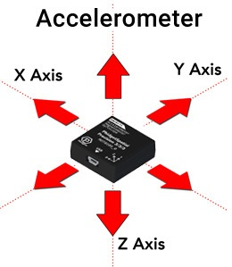
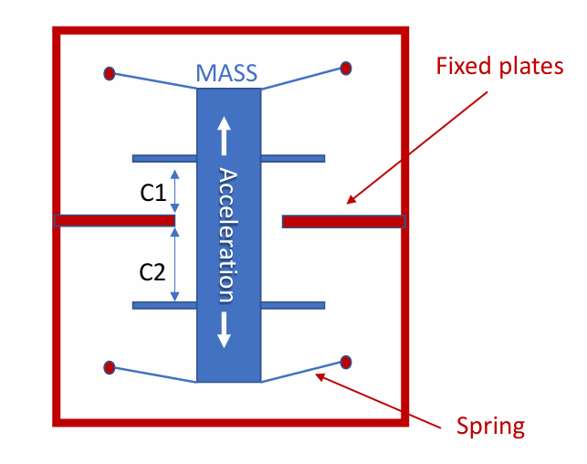
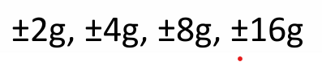
ADXL345 ACCELEROMETER
Detects change in capacitance to measure acceleration
3 axis accelerometer
The data of each axis is represented using two’s complement on 16 bits
Can be controlled with I2C or SPI
Multiple ranges

Slide 8
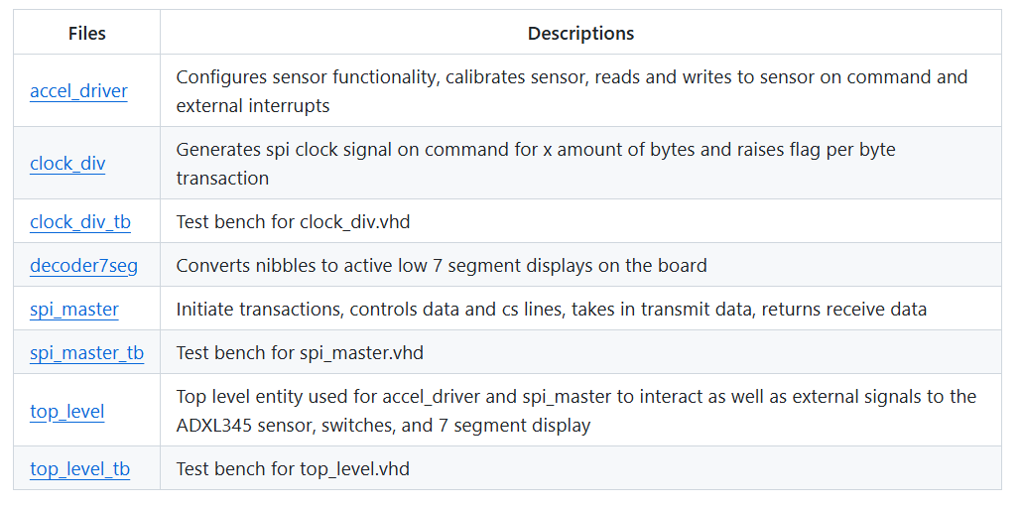
Blake Johnson’s code
Uses SPI due to its higher speed and Johnson’s interest for the protocol
Uses +/- 2g range and 10 bits resolution
Top level ouputs the value of the accelerometer on hexes

Slide 9
Challenges of running Johnson’s code on Quartus
Pin mapping was not provided
No prior VHDL experience; I had to learn through tutorials

Slide 10
Challenges of running Johnson’s code on Logisim
Had to create a new map with pin mapping for the accelerometer : TERASICDE10LITE_GSENSOR.xml
Stripped down Johnson’s code to only get the values of the accelerometer
Multiple VHDL modules in Logisim must be initialized in a particular way (used application16x2display.circ as template)

Slide 11
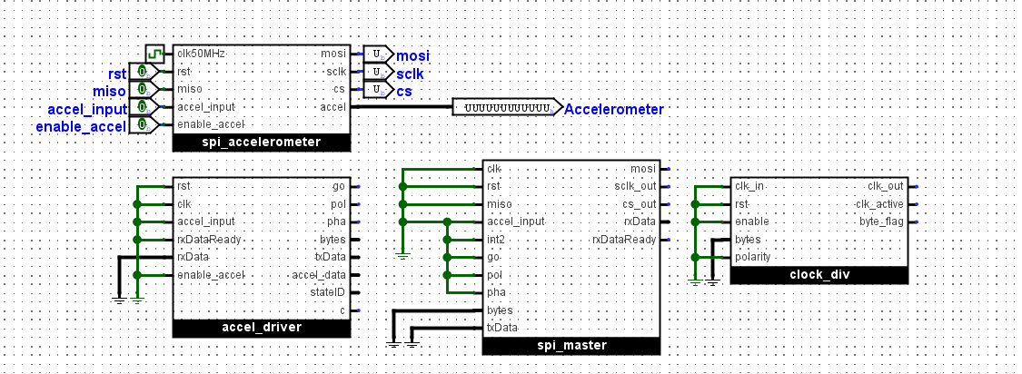
Challenges of running Johnson’s code on Logisim
accel_driver_logisim: initializing all the modules

Slide 12
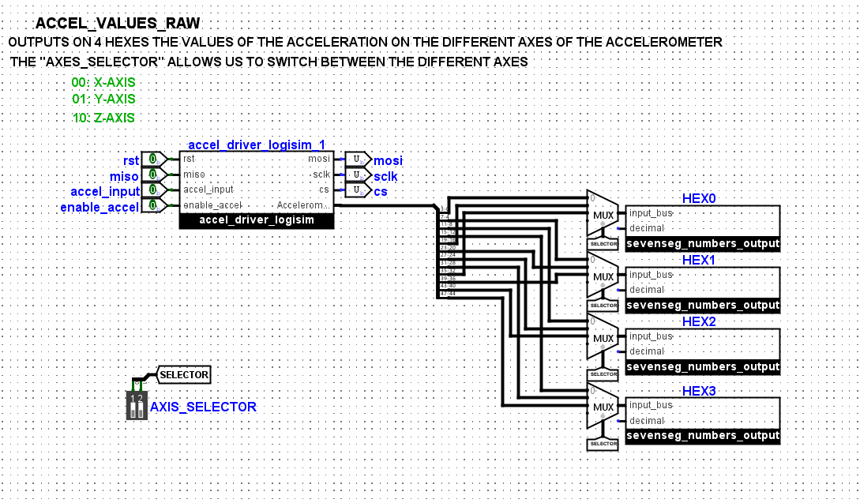
accel_values_raw: outputs the raw value of the accelerometer on the hexes

Slide 13
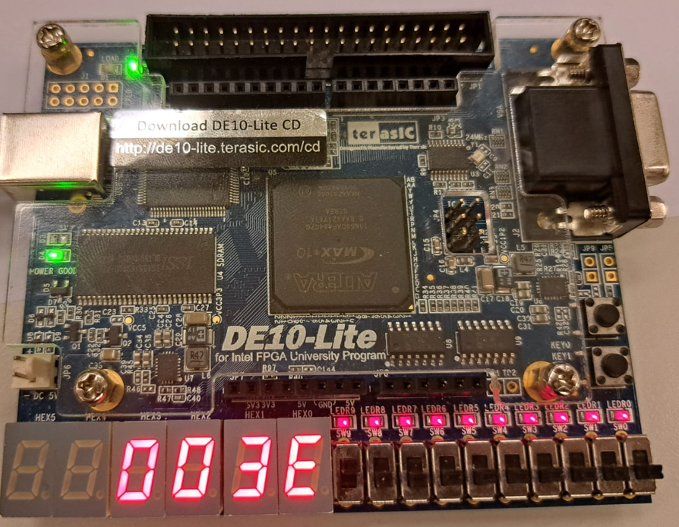
Raw output

Slide 14
Corrections
Calibration:
Sensor has an offset that needs to be corrected
Scale:
The value of the read sensors have to be understandable to a human
Filter:
The noisy value needs to be filtered

Slide 15
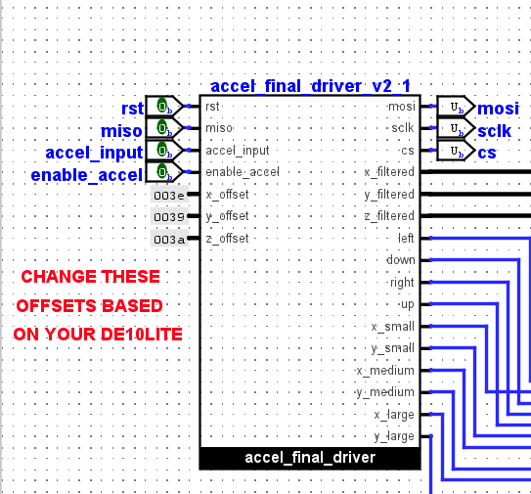
Calibration
An offset for each axis can be subtracted
The offset can be found using the calibration_tb circuit
Offset is an input of the driver

Slide 16
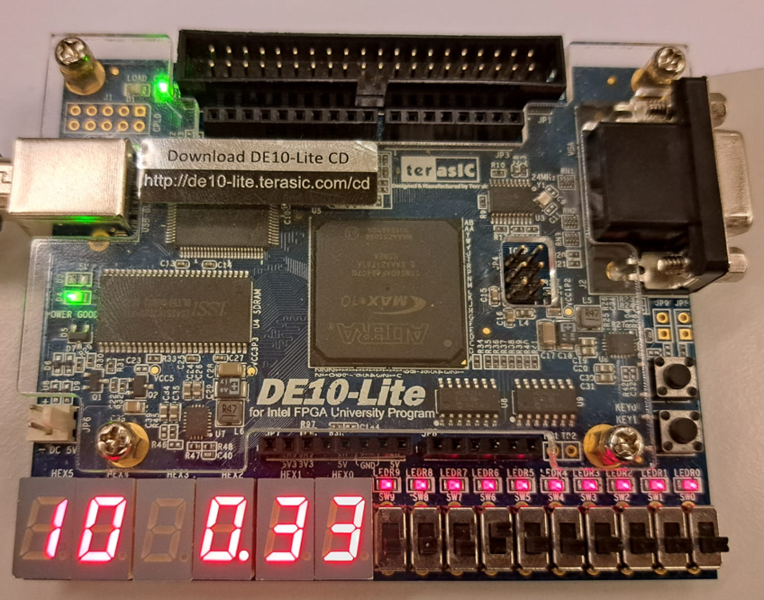
Calibration
Accelerometer
Value (IN DEC)
Offset applied
(IN HEX)
Axis Selector

Slide 17
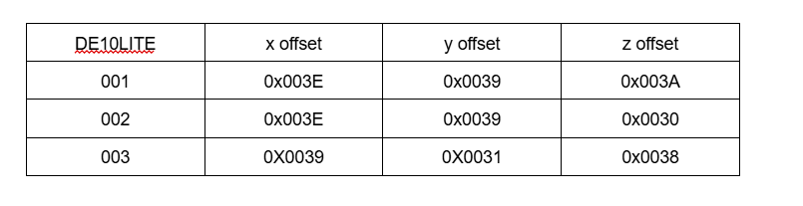
Calibration
Mean = 56.22
SD = 4.89

Slide 18
Scale
We want the output of the accelerometer to be in [g=9.81 m/s^2]
We want to detect tilt so our range is between 0 and 1 [g]
Let’s look at the x axis:
When the DE10Lite is fully vertical the value read by the accelerometer is 128.
We want that value to be 1 since it is experiencing just the earth’s acceleration
We divide all values by 128!

Slide 19
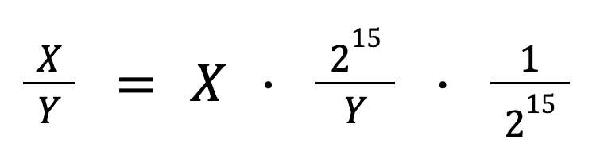
Scale
The Logisim divider is not synthesizable therefore we need a trick to divide
Dividing by 2^15 is equivalent to a bit right shift by 15 places.
However, this answer gives us a number between 0 and 1 which in two’s complements just gets rounded to 0.

Slide 20
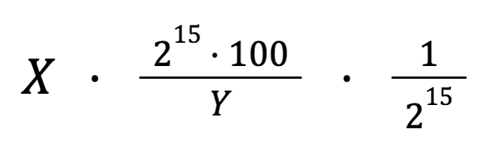
Scale
This modified equation gives us a number between 0 and 100
The logisim right shift is not synthesizable therefore we need to code this in VHDL

Slide 21
Filter
Use a moving average filter
Slows down the system
Use the filter ONLY for small angle changes (less than 3.3 degrees)
For big angle changes we use the unfiltered value to get a fast response
How do we choose the amount of samples to use? We want a standard error less than 0.01 since that gets rounded to 0 (resolution of a hundredth)

Slide 22
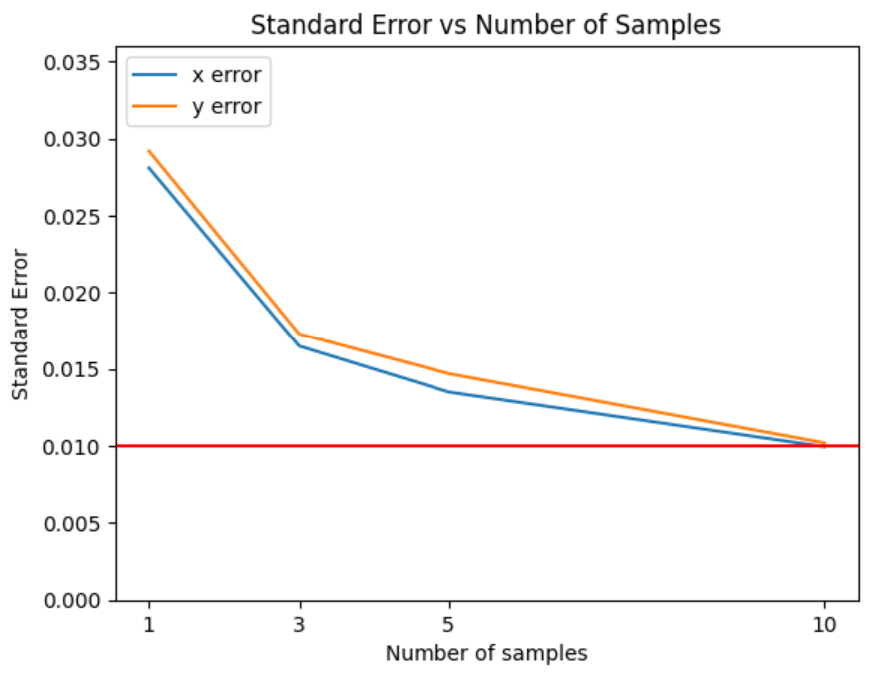
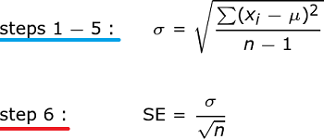
Filter
Mean = 0, n = 100
We just need to average over 10 samples

Slide 23
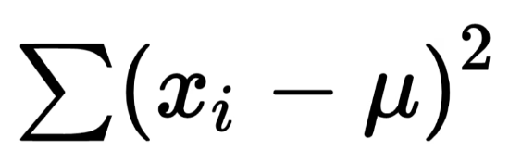
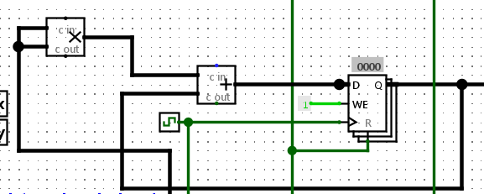
Filter
The error was calculated using error_calc_tb
We use a counter to count the amount of samples

Slide 24
The final driver
Miso, accel_input, mosi, sclk, cs can be mapped using PIN_MAPPING.txt
X_filtered, y_filtered and z_filtered are on 16 bits
Using comparators the driver outputs if the board is tilted left, right, up or down
It also outputs if the angle is small, medium or large
X > 0.1 : left X < -0.1 : right
Y > 0.1 : down Y < -0.1 : up
0.1 < |X or Y| < 0.4 : Small
0.4 < |X or Y| < 0.7 : Medium
0.7 < |X or Y| < 1.00 : Large

Slide 25
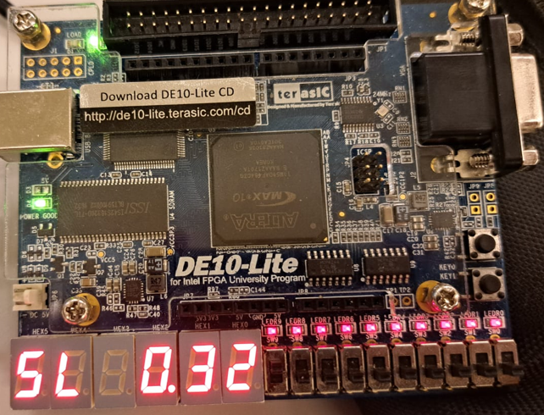
The final driver @ 1MHz

Slide 26
Using the accelerometer
Import the accelerometer_final.circ Logisim library
From the library use accel_final_driver in your application
If needed the accelerometer can be calibrated using calibration_tb
Map the pins of the accelerometer using TERASICDE10LITE_GSENSOR.xml map

Slide 27
The Application : Get to Zero
The game initializes two random values: one for the X value and one for the Y
The player needs to get these values to 0 by tilting the board
There are 3 ways to get to 0: either by getting to -100, 0 or 100.
After the player gets to 0, the time it took the player is shown

Slide 28
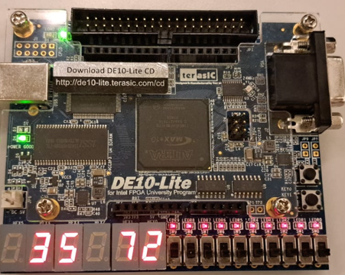
Concepts used in the application
Pseudo random value generation using clocks
FSM used to keep track of what state the game is in
Animation made using MUX to give the game better visuals

Slide 29
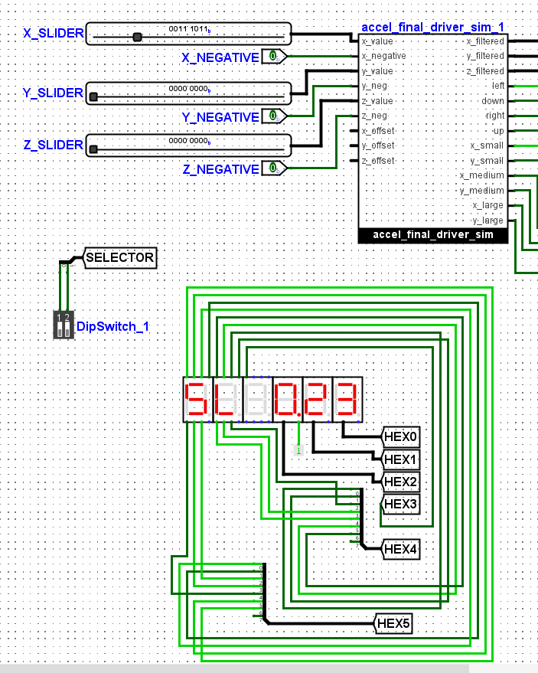
Simulator for the driver
In order to simulate in Logisim, all the modules that used VHDL blocks had to be converted
The tilt of the accelerometer is simulated using sliders
A bit can be activated on each axis to make the value negative

Slide 30
Results & Critical Assessment
All objectives for the accelerometer were achieved
The driver was implemented
The values of the accelerometer can be viewed on the FPGA
An application was developed using the driver
A simulator was made to view the drivers output in Logisim
The driver is easy to use to develop an app

Slide 31
Conclusion & Outlook
The accelerometer has many features that were not explored: changing the range, free fall mode, single and double tap mode.
Precise measurements can be taken to test the precision
I believe the complexity of the accelerometer has been abstracted enough to be used by students.

